Slide 1


The First Year
Goals and Objectives for the GM
KFPD
January 20, 2021
Brent Ives, Principal
BHI Management Consulting

Slide 2
Introduction
• INTRODUCTION
- Brent Ives, BHI Management Consulting
• Organizational consultant to Special Districts (20 years)
• BHI Management Consulting - Strategic Planning - Supervisor training – Board Dynamics Board/Manager relations - workshops, etc. – many statewide sanitation clients
• 25 years Technical Manager In Engineering at LLNL
• Served 23 years on Tracy City Council (most recent 8 years as elected Mayor), numerous regional Boards/Commissions. …

Slide 3
Overview
Discuss typical Board/GM Relationship
The Dependencies on Board Dynamics to make this work
  Board Dynamics
  Brown Act
Develop Performance Goals and Objectives for Bill’s first year

Slide 4
Down-selecting guidance
Critical or important or “just nice to have”?
Proven professional - √√
Specific set of years with fire protection or CSDA certification requirement √√(willingness w/in timeframe)?
BA/BS or higher in relevant field, public administration, fire? Which is most important? Which is desired/required? – √√Bach. Required/equivalent
Understands emerging State regulations – (Yes!)
Grant funding opportunities (nth)?
3-5 yrs. in mgmt. with public executive level???
Demonstrated leader, communicator, planner. (Crit)
A candidate that can establish and maintain effective and productive relations with stakeholders, community, etc. (Crit)
Strong financial management skills (Crit)
Personality (comfortable working with a variety of personalities, open-minded, )
Experience working with a governing Board, diplomatic…goals and objectives, best professional recommendations to Board, etc.? – (Board personality management – versitile, experience with and the ability to work with any Board)
Highest ethical stds. - (YES!!)
An individual who embraces modern business, office and communication technologies.

Slide 5
From: ‘52 Ways to be a Better Board’
They manage their Executive well
• They evaluate their Executive at set intervals
• They evaluate their Executive as an Executive
• They look at achievements and results, while expecting professional conduct
• They model professional conduct
• They clarify for their executive collective and clear direction and expectations of WHAT needs to be done/achieved by WHEN…nor HOW
• They do not focus so closely at HOW things are being done or the activities of the CEO
• They develop clear goals and objectives for your Executive that link with the overall direction is the art of this process, including resource/asset management…
Book – Chapters #7, #17, #19, #35, #45, and #47.

Slide 6
Value Driven
Understanding Roles
Beliefs
Vision
Priorities
Policies
Labor Contracts
ENDS
Governance
Team
Strategic Goals Success Indicators
How
What
Strategies
Tactics
Techniques
Methods
MEANS
Administration
and Staff
Skill Driven
©Copyright 2001 California School Boards Association
Notes:
Discuss: Getting the Board Ready: I to We mindset, Unity of Purpose, then get into the board’s role – value or belief driven – NOT skill based.

Slide 7
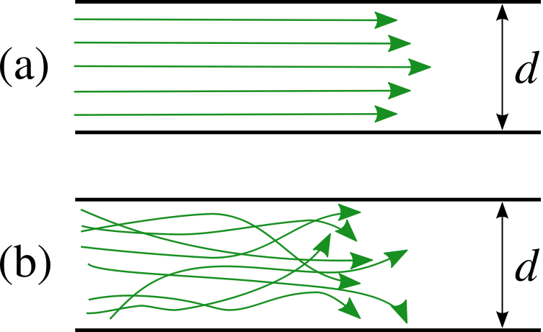
Board Relations/Dynamics
EFFICIENCY!!
Laminar flow
means more flow -
EFFICIENCY
Turbulent flow
means less output,
chaos and
INEFFICIENCY

Slide 8
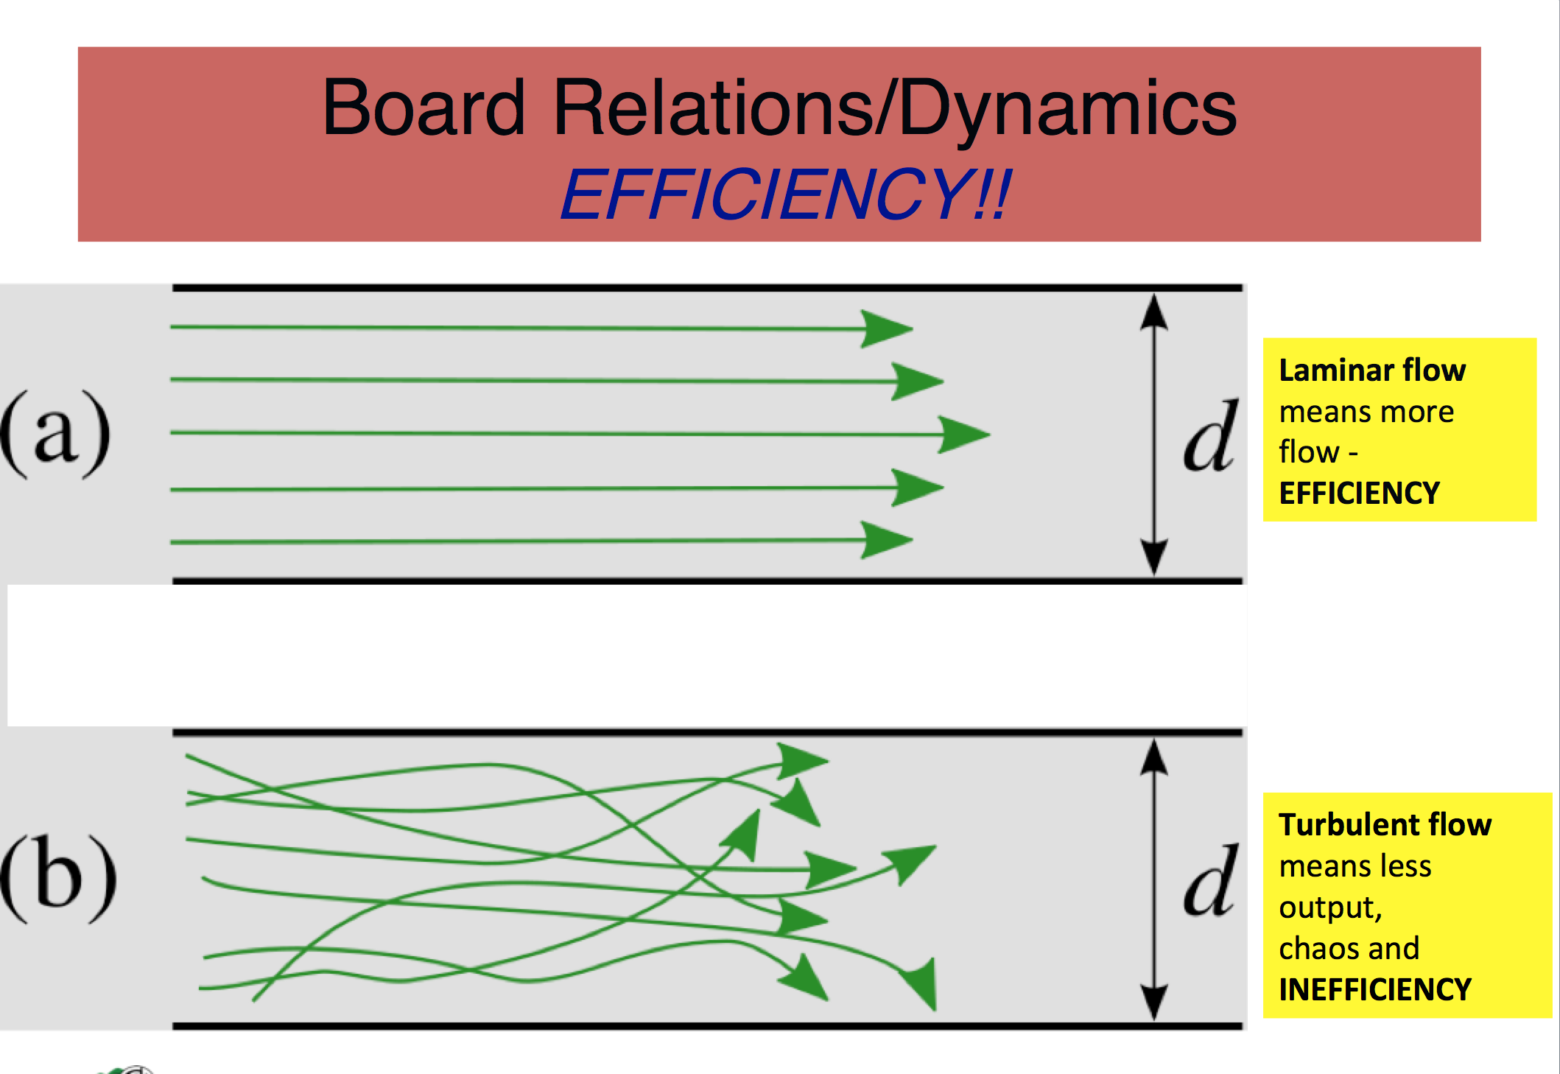
Board Dynamics at KFPD
This Board has the same challenges this year with more consistent help and less distractions:
Is that true? (No Manager…RGS … no clear direction for working with Police District … others.)
Differences can become large, disrespectful, insulting with ease.
If Board dynamics fail (treat one another with respect)… makes Bill’s job very difficult.
If Board dynamics do not come to a clear direction (a plan) … it makes Bill’s job very difficult
Good Public Agencies run on process, defined by policy and solid norms …’All of you have the same opportunity to provide opinion, make your case and vote, there is no strata.
None of you have unilateral authority to represent the District, speak for the District, authorize anything for the District, or demand anything from Bill…..majority speaks
The public simply expects that you’ll be able to work out your differences to their benefit… as good representatives.
If the Board allows any such thing, it effects this District, and the ability
to get things done

Slide 9
Topical Discussions
Boards, Brown Act and Confidentiality
• Board members should practice their “Duty of Loyalty” to their fellow members
Duty of Loyalty is part of your fiduciary responsibility to the entirety of those you serve,…all. You are all elected by the same constituency
- “and I take this obligation freely, without any …”
• One of the elements of the Duty of Loyalty is confidentiality
- not to speak about closed Board matters without Board permission
- lack thereof hampers the decision making ability of the Board when taking on the critical aspects of business in closed sessions.
• One of the benefits of confidentiality is the trust it yields

Slide 10
Topical Discussions
Boards, the Brown Act, and Confidentiality
• The Brown Act has quite specific rules regarding meetings
  Meetings are generally open to the public.
  “Meetings” of the Board can be perceived to occur when a voting majority is present.
  The Act defines the rare set of purposes and circumstances of closed meetings as well. (Negotiations, public property matters, employee performance or health matters, etc.)
  Closed meetings have specific reporting rules
  All who attend are deemed capable of confidentiality
  The Act has language for those who ignore the confidentiality rule

Slide 11
Topical Discussions
Boards, the Brown Act and Confidentiality
Breach is unlawful:
54963. (a) A person may not disclose confidential information that has been acquired by being present in a closed session authorized by Section 54956.7, 54956.8, 54956.86, 54956.87, 54956.9, 54957, 54957.6, 54957.8, or 54957.10 to a person not entitled to receive it, unless the legislative body authorizes disclosure of that confidential information. (b) For purposes of this section, "confidential information" means a communication made in a closed session that is specifically related to the basis for the legislative body of a local agency to meet lawfully in closed session under this chapter. (c) Violation of this section may be addressed by the use of such remedies as are currently available by law, including, but not limited to: (1) Injunctive relief to prevent the disclosure of confidential information prohibited by this section. (2) Disciplinary action against an employee who has willfully disclosed confidential information in violation of this section. (3) Referral of a member of a legislative body who has willfully disclosed confidential information in violation of this section to the grand jury.

Slide 12
Topical Discussions
Boards, Brown Act and Confidentiality
• Breach of Confidentiality is one of the worse breech of Board dynamics
• It yields distrust within the decision team
• It causes suspicion, poor decision making and inefficiency
• Its therefore bad for the District, and
• Its unlawful…

Slide 13
GM Goals and Objectives
These are an annual best practice for Boards of Directors.
They outline clear expectations for GM performance.
Next Nov/Dec. you will evaluate his performance on these factors. If in-between things change, you must all be involved in the change.
First year set is crucial…can be very simple.
Not very long, taking into account that it’s the first year.

Slide 14
GM Goals and Objectives
Project yourself into next Nov/Dec and reflecting on Bill’s performance, what professional attributes would you like to brag about Bill?
  He is working well with our partner Districts, keep relationship strong.
  A comprehensive understanding of the District’s needs closely tied to the Mission statement.
What areas of Board communication do you expect?
  He is open, honest, conscientious, and operates with integrity.
What would you like to say he has accomplished, started or achieved?
  Significant progress on the building (solve the building occupancy issues).
  A broad long-term strategic plan in place (including financial plan).
  Significant progress on emergency evacuation plan.
  Assisting and facilitating the EPC in setting its priorities.
  Make progress toward updating the District policy manual.

Slide 15
Framing the candidate (Board inputs)
What are critical attributes for you GM?
  Financial chops
  Thick skin/Patience w/ Kensington
  Comfortable to do it all, part-time and speak for the District
  Administrative Professional
  Understand labor relations and the balance
  Ability to bridge any gaps, communicate well, in a/the Board with balance

